Slide 1
Lecture 5
Simple Linear Regression

Slide 2
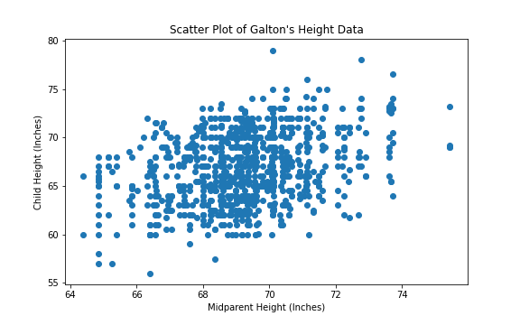
Linear Regression
Once we have the correlation coefficient, we know something about the relationship between the two variables
If we are given a new midparental height, how might you predict their child’s height?
Thoughts?

Slide 3
Linear Regression
Biggest problem with predicting:
There isn’t one child height for each midparental height - what height for their child should you pick?
Maybe we can take averages?

Slide 4
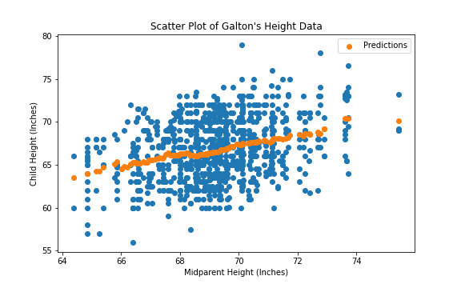
Predicting Heights 1.0
Bin the heights, find the average of each bin, and use that as the prediction

Slide 5
Predicting Heights 1.0
Pros and Cons of using this method?
On average you will be correct
Lot of data to store - might be kind of cumbersome
What if you want to predict something that hasn’t already been observed? Outliers?
How to remedy
Since we know that the data is approximately linear, let’s just make some equation to approximate the data and call it a day!
When we want to make predictions - all we need is some simple math
y = mx + b predicted_child_height = m * midparent_height + b

Slide 6
Predicting Heights 2.0
Which line though? What are the values of m and b - the slope and the intercept?

Slide 7
How to find the best line
One way - “numerical” - keep guessing and checking until you have a “good” line - how do we define good?
Another way - “analytical” - use what we know about the relationship between the two variables to just figure out what the line is through math

Slide 8
RMSE
Remember - our goal is to find a line that is good at approximating the data

Slide 9
RMSE
When we predict, we just plug in the Midparent Height into our equation and it will return our predicted child height: predicted_y = m*x + b
No line will be able to predict every point perfectly, but some lines clearly predict closer to points than others
We want to somehow minimize the amount of “error” that our line makes in our predictions
Notes:
Consider the yellow point that I’ve highlighted - let’s think about what each line will make as a prediction - it will be the corresponding lines on that vertical area, correct?

Slide 10
RMSE
Our line makes errors for every point - but we want to make this the smallest possible
Can we just add up all the errors together and then try to make that as small as possible?
No! Some estimates will overestimate while others will underestimate
Adding these together will cancel them out, which we don’t want!
Possible solutions?
Squaring all the errors
Then we take the mean again
And then square root it
Root Mean Squared Error

Slide 11
RMSE
Sounds very similar to how we calculated Standard Deviation
Instead of considering how far away on average are we from the mean
Now we are considering how far away on average are we from the truth

Slide 12
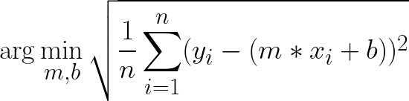
RMSE
This is also known as “Least Squares” - minimizing the squared error
Computers do most of this work for us but the problem looks like this:
Find the m and b that makes this quantity the smallest:

Slide 13
RMSE
Square Root it All
Squared Error
Prediction
Average Squared Error
Error
(Demo)

Slide 14
Analytical Solution
We know the correlation between the two variables, which gives us information about the two variables in standard units
When x and y are both in standard units, the regression line has slope r and passes through the origin. In other words,
estimate of y = r * x when both variables are measured in standard units

Slide 15

Analytical Solution
(Estimate of y in standard units) = r * (x in standard units)
We know all of these numbers except for the estimate of y!
So we can solve for the estimate!

Slide 16
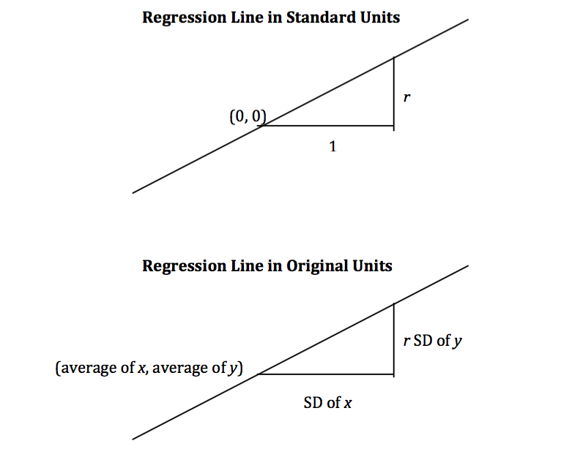
Analytical Solution

